Slide 1


Social Buzz
Content Analysis

Slide 2


Today's agenda
Project Recap
Problem
The Analytics team
Process
Business Question
Insights
Summary
Dashboard

Slide 3

Social Buzz is a technology company in the social media and content creation industry, currently experiencing rapid and unanticipated growth.
Accenture will be offering advisory services to Social Buzz with the objective to:
Conduct an audit of Social Buzz’s big data practices
Offer recommendations for a successful IPO
Conduct an analysis of content categories to identify the 5 most popular Social Buzz content.
Project Recap
Duration: 3-month Initial Project

Slide 4

Problem
Experiencing rapid growth more than anticipated
100,000 pieces of is highly unstructured content everyday. Approximately 3million, every month
Small company with limited resource to manage current scale

Slide 5



Andrew Fleming
Chief Technical Architect
The Analytics team
Marcus Rompton
Senior Principle
Bisola Olagoke
Data Analyst

Slide 6
Brief/Data Understanding
Process
1
Data Cleaning
2
Data Modelling
3
Analysis
4
5
Highlighting Insights

Slide 7


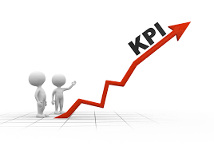
Additional Analysis
What are the five categories that have consistently generated the highest user engagement?
What are the key trends and factors driving engagement in these top five categories?
Business Questions
Total Score
The number that quantifies how “popular” each reaction is.
Key Performance
Indicator
Image source:
https://irm.com.au/good-business-analysis-questions/
https://b-scpa.com/2018/12/06/key-performance-indicators-and-your-business-part-1-of-2/

Slide 8
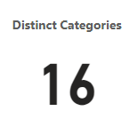
Insights
ANIMAL
THURSDAY
Highest general user engagements
First category

Slide 9
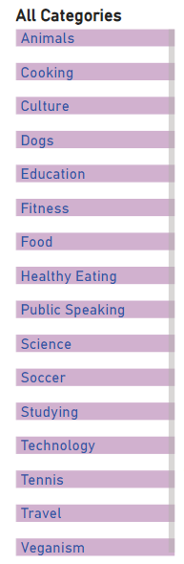
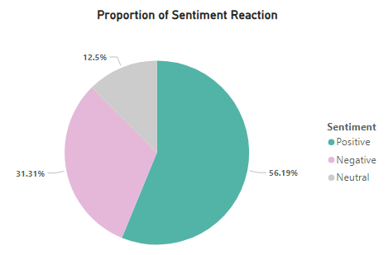
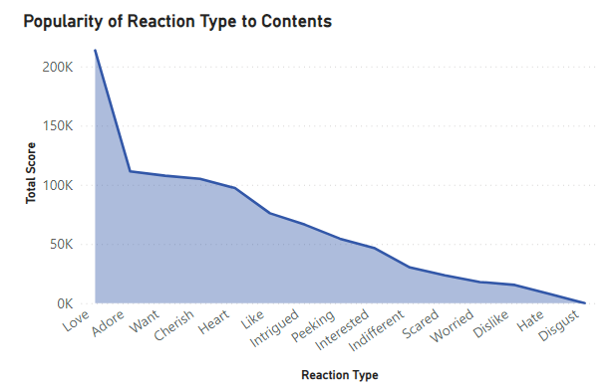
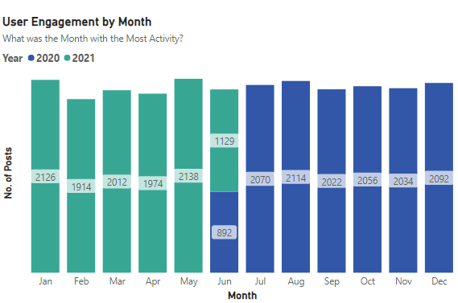
Insights
There are 16 unique content categories.
Positive sentiments contributed to over half of the total sentiment, with over 56% of reactions.
The top three reaction types are Love, Adore and Want.
Activities were highest in May 2021, Jan 2021 and Aug 2020, respectively. Low engagement in June 2020 and 2021.
General Content Performance

Slide 10
What are the five categories that have consistently generated the highest user engagement?

Slide 11
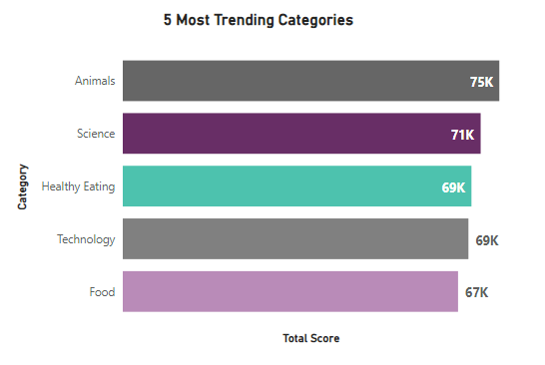
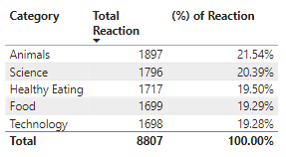
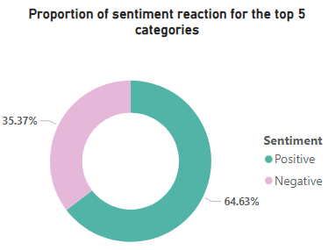
Insights
Top 5 Categories
About 65% positive sentiment among the top 5.
Animal contributing over 21.5%
Image source: https://www.istockphoto.com/photos/top-5

Slide 12
Additional Analysis
What are the key trends and factors driving engagement in these top five categories?

Slide 13
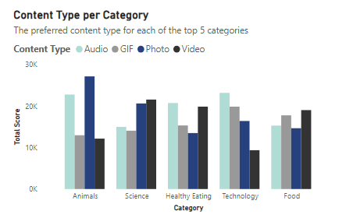
Insights
Content Type is a factor that contributes to user engagement
User engagement vary by the content type
Top 5 Categories
Animal contents are most preferred in photo, followed by audio
Science contents are most preferred in video, followed by photo
Healthy Eating contents are most preferred in audio, followed by video
Technology contents are most preferred in audio, followed by GIF
Food contents are most preferred in video, followed by GIF

Slide 14
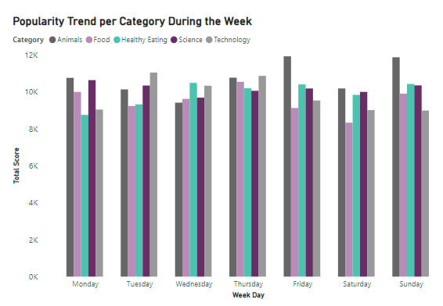
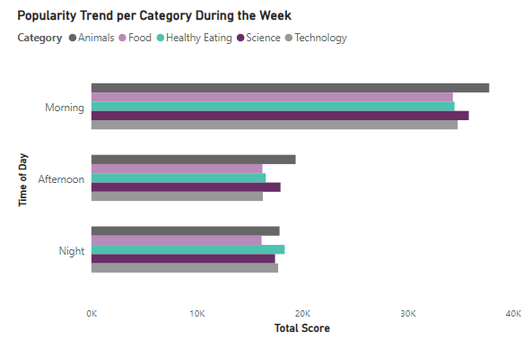
Insights
Another factor that contributes to user engagement is the day of the week.
A common trend is that preferred content vary by the day of the week.
Animal content are preferred mostly on Friday and Sunday
Technology content are preferred mostly on Tuesday and Thursday
Top 5 Categories
Time of the day is a factor that contributes to user engagement
User engagement is highest in the morning—animal content, followed by science content trend the most.
Healthy eating content tends to trend at night.

Slide 15
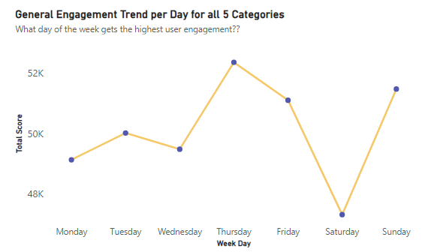
Insights
Engagement are highest on Thursday.
Top 5 Categories
Sundays are in the second place while Fridays are third place.
User engagements are lowest on Saturdays

Slide 16

Analysis
Animal and science are the two most popular content categories showing that people are animal lovers and have a desire for knowledge.
Food content are very popular, both healthy and unhealthy. This indicates that people enjoy exploring a wide range of culinary experiences, from balanced meals to occasional treats.
Summary
Key Insight
Content type, day of the week and time of the day are drivers of activities with Thursdays being the most active days of the week. Contents can be posted and maximized to advantage using this insight.

Slide 17

Summary
Possibilities
Advertising and Sponsored Content
Subscription-Based Content
Merchandise and E-commerce Integration
Data-Driven Insights as a Service
Tailored advertising opportunities and optimise ad placements
Sponsored content collaborations between influencers and brands
Consider introducing subscription models or premium content offerings specifically within the top trending categories
Provide businesses and advertisers with in-depth data on user behavior, trends, and engagement metrics
Explore opportunities to sell merchandise and products related to the top trending categories
Enhance revenue potential
Appealing to potential investors, aligning with the goal of going public by year-end
Image Source: https://amandawaymire.wordpress.com/outcomes/
Notes:
Fostering sponsored content collaborations between influencers and brands in these niches can boost revenue.

Slide 18
Summary
While this analysis has provided valuable insights and potentials, it is time to advance to a more scalable, real-time production setting for the comprehensive understanding of your business operations. We are well-prepared to offer guidance and support in making this transition.
Next Step

Slide 19
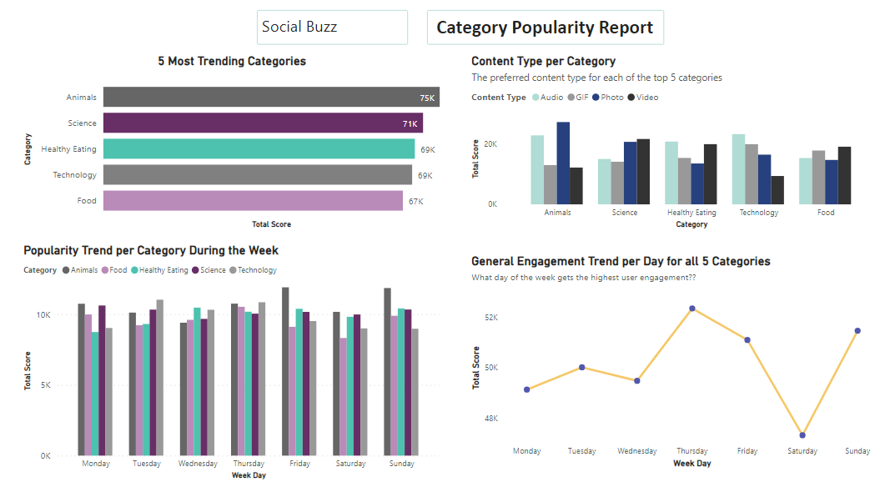
Dashboard

Slide 20

Thank you!
ANY QUESTIONS?

